Slide 1
Lecture 04
Bill Perry

Slide 2
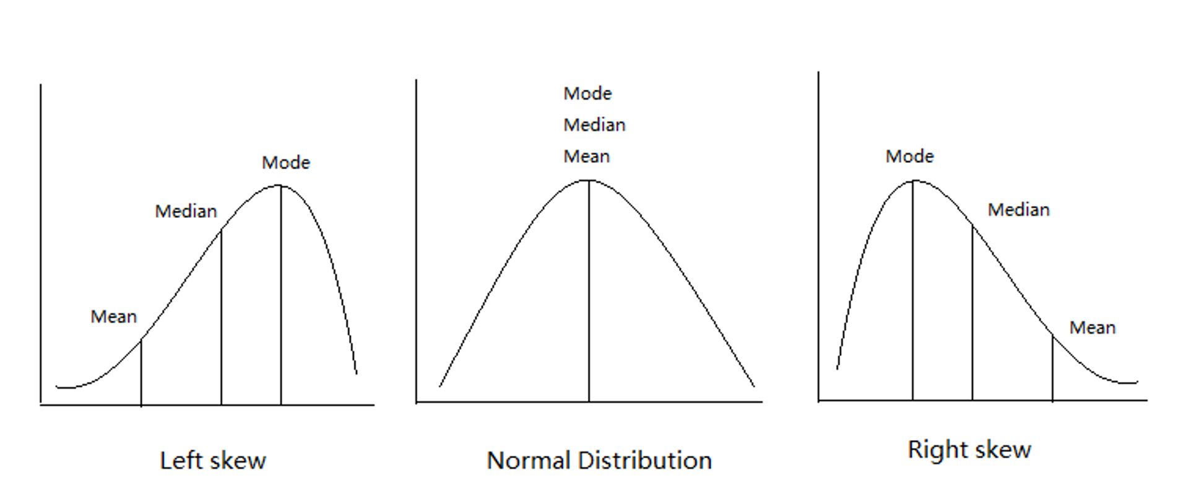
Lecture 3: Review
Introduction to histograms or frequency distributions
Probability Distribution Functions (PDF)
Descriptive Statistics
Center - mean, median, mode
Spread - range, variance, standard deviation
Our last graphs

Slide 3

Lecture 4: Lecture Overview
The objectives:
Introduction to hypothesis testing
The standard normal distribution
Standard error
Confidence intervals
Student’s t-distribution
H testing sequence
p-values

Slide 4
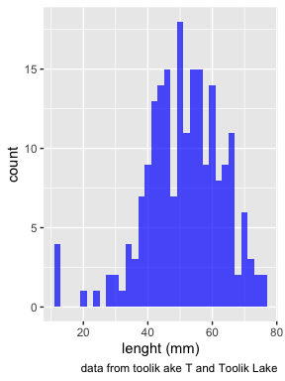
Lecture 4: Standard normal distribution
To understand hypothesis testing need to understand standard normal distribution
Recall - sculpin in Toolik Lake
n = 208
mean = 51.69 mm
std dev = s = 12.02 mm
Weight distribution ~normal

Slide 5
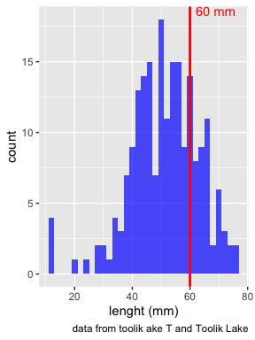
Lecture 4: Standard normal distribution
You want to know things about this population like
probability of a baby born at the hospital having a certain length (e.g., > 60 mm)
Can solve this by integrating under curve
But it is tedious to do every time
Instead
we can use the standard normal distribution (SND)

Slide 6
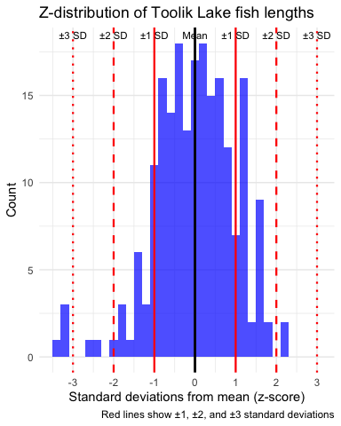
Lecture 4: Standard normal distribution
Standard Normal Distribution
“benchmark” normal distribution with µ = 0, σ = 1
The Standard Normal Distribution is defined so that:
~68% of the curve area within +/- 1 σ of the mean,
~95% within +/- 2 σ of the mean,
~99.7% within +/- 3 σ of the mean
*remember σ = standard deviation

Slide 7
Lecture 4: Standard normal distribution
Areas under curve of Standard Normal Distribution
Have been calculated for a range of sample sizes
Can be looked up in z-table
No need to integrate
Any normally distributed data can be standardized
transformed into the standard normal distribution
looked up ion a table

Slide 8
Lecture 4: Standard normal distribution
Done by converting original data points to z-scores
Z-scores calculated as:
$\text{Z = }\frac{X_{i}−μ}{σ}$
z = z-score for observation
xi = original observation
µ = mean of data distribution
σ = SD of data distribution

Slide 9
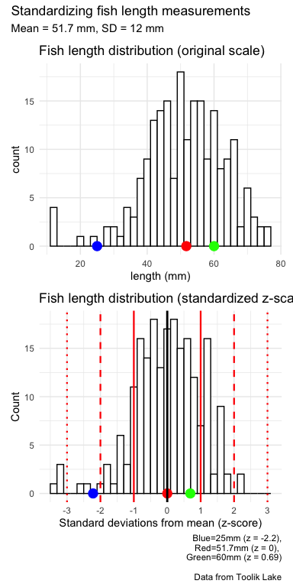
Lecture 4: Standard normal distribution
Thus:
z-score = value - mean/s
z-score of 25mm = (25 - 51.7) / 12 = -2.225
z-score of 51.7mm = (51.7 - 51.7) / 12 = 0
z-score of 60mm = (60 - 51.7) / 12 = 0.6916667

Slide 10
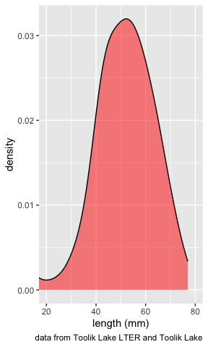
Lecture 4: Standard normal distribution
Area under curve (probability) of standard normal distribution is known relative to z-values
Knowing z-value, can figure out corresponding area under the curve
What is the area under curve < 0?

Slide 11
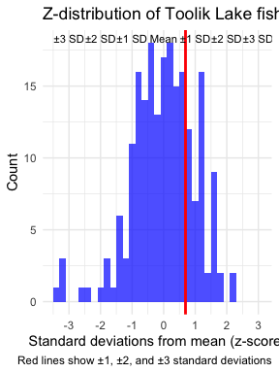
Lecture 4: Standard normal distribution
Here is z-score table for right side or positive values of the z distribution (z > 0)
Numbers give area under the curve to left of a particular z-score
say 60 mm as a z score of 0.6916667

Slide 12
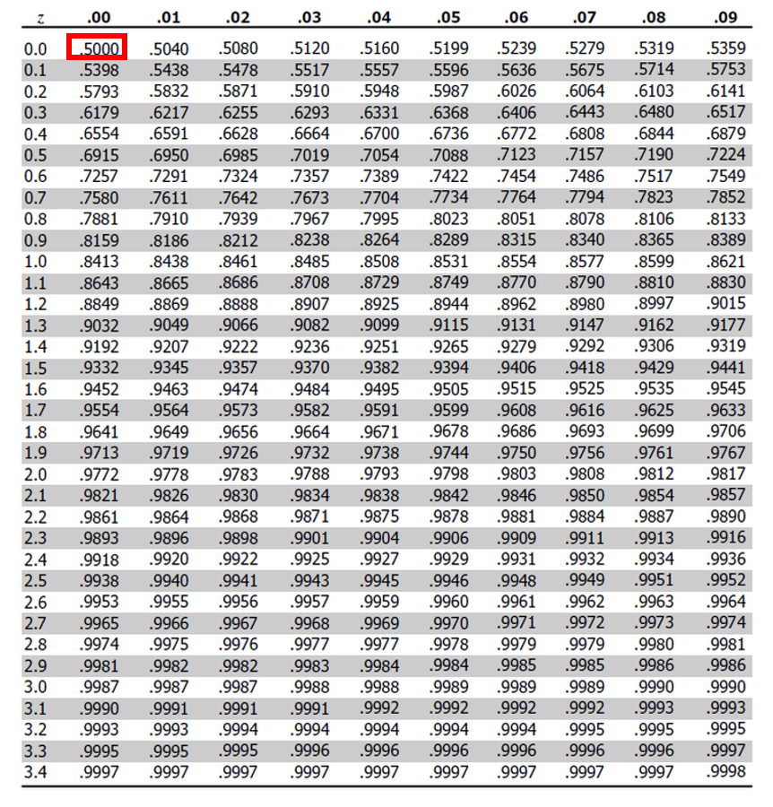
Lecture 4: Standard normal distribution
Area under curve (probability) of standard normal distribution is known relative to z-values
Knowing z-value, can figure out corresponding area under the curve
What is the area under curve < 0?
0.5 of the area of the curve is contained to the left of z = 0.00

Slide 13
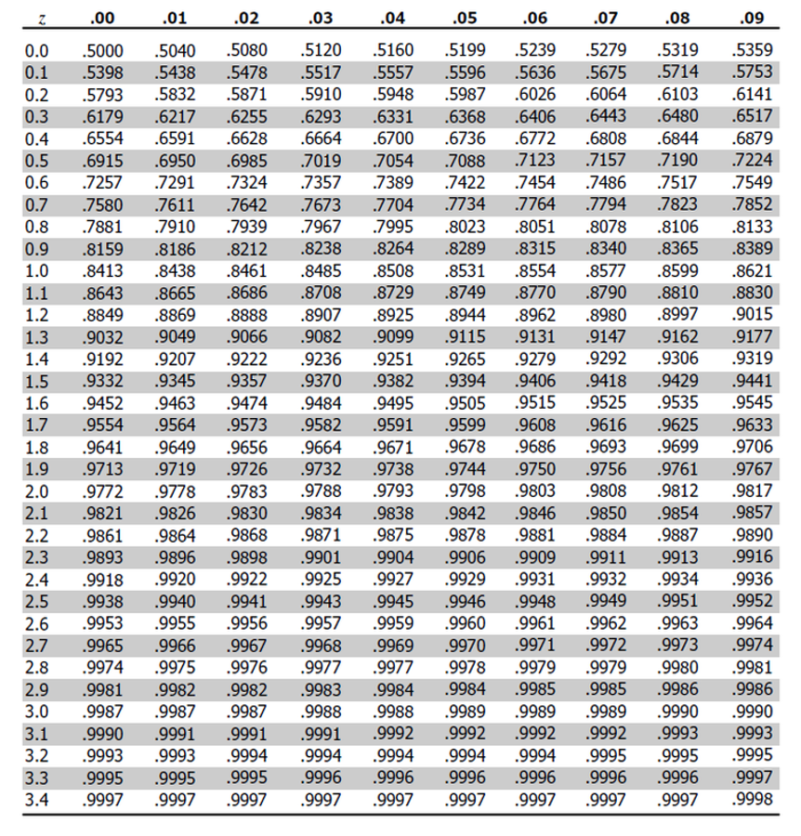
Lecture 4: Standard normal distribution
area of the curve is contained to the left of z = 1.22
0.8686 or 86.9%

Slide 14
Lecture 4: Standard normal distribution
What is the area of the curve is contained between of z = 0 and z=1.5?

Slide 15
Lecture 4: Standard normal distribution
What is the area of the curve is contained between of z = 0 and z=1.5?
approximately 0.4332 (or 43.32%)
To calculate this from a standard normal table:
To find the area under the standard normal curve between 0 and 1.5 using this table:
Locate z = 1.5 in the table - 0.9332.
represents P(Z ≤ 1.5) - probability Z is less than or equal to 1.5
Since need area between 0 and 1.5 - need to subtract P(Z ≤ 0) from P(Z ≤ 1.5)
From table - P(Z ≤ 0) = 0.5000.
Therefore, the area between 0 and 1.5 is: 0.9332 - 0.5000 = 0.4332.

Slide 16
Lecture 4: Standard normal distribution
What is the area of the curve is contained to the left of z = -1?

Slide 17
Lecture 4: Standard normal distribution
What is the area of the curve is contained to the left of z = -1?
Locate row for 1.0 - (table shows absolute value of z) and the column for .00
value = 0.8413 - represents P(Z ≤ 1.0)
However want P(Z ≤ -1.0)
need to use the symmetry property of the standard normal distribution:
P(Z ≤ -1.0) = 1 - P(Z ≤ 1.0) = 1 - 0.8413 = 0.1587
Therefore, 15.87% of area falls to the left of z = -1.0

Slide 18
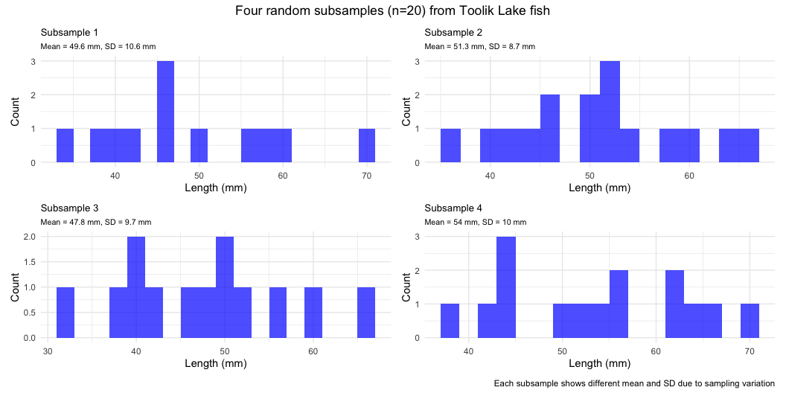
Lecture 4: Standard error
Take random samples from fish population:
3 random samples (each n=20) from population:
Notice the sample statistics and distributions

Slide 19
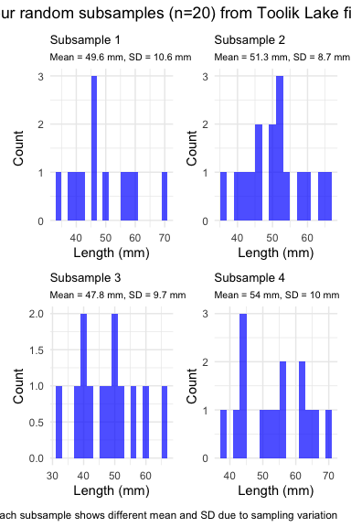
Lecture 4: Standard error
Every sample gives slightly different estimate of µ
Can take many samples and calculate means
plot the frequency distribution of means
get the “sampling distribution of means”

Slide 20
Lecture 4: Standard error
3 important properties:
Sampling distribution of means (SDM) from normal population will be normal
Large Sampling distribution of means from any population will be normal (Central Limit Theorem)
The mean of Sampling distribution of means will equal µ or the mean

Slide 21
Lecture 4: Standard error
Given above
can estimate the standard deviation of sample means
“Standard error of sample mean”
How good is your estimate of population mean? (based on the sample collected)
quantifies how much the sample means are expected to vary from samples
gives an estimate of the error associated with using $\overset{‾}{y}$ to estimate $μ$…

Slide 22
Lecture 4: Standard error
$σ_{\overset{‾}{y}}=\frac{σ}{\sqrt{n}}$
but rarely know σ, so use s $s_{\overset{‾}{y}}=\frac{s}{\sqrt{n}}$ Where: $s_{\overset{‾}{y}}$ = sample standard error of mean s = sample standard deviation n = sample size

Slide 23
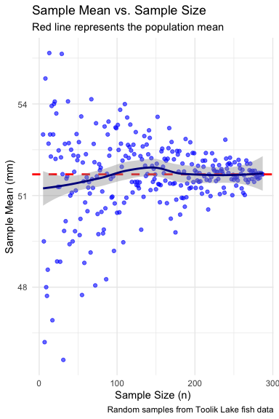
Lecture 4: Standard error
Notice: - $s_{\overset{‾}{y}}$ depends on - sample s (standard deviation) - sample n - ($s_{\overset{‾}{y}}=\frac{s}{\sqrt{n}}$)
How and why? - Decreases with sample n - number - increases with sample s - standard deviation
Large sample, low s = greater confidence in estimate of $μ$

Slide 24
Lecture 4: Confidence intervals
Every sample gives slightly different estimate of µ (population mean)
Want to know how accurate our estimate of µ is from a sample
Do this by calculating confidence interval:
Range of values that will contain the true population mean with a certain probability

Slide 25
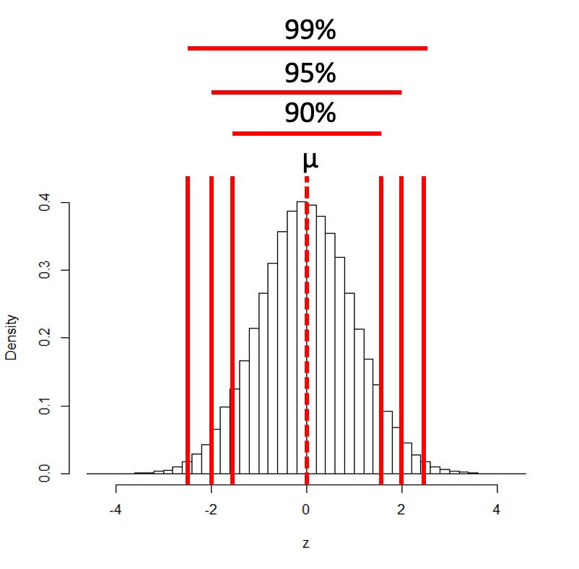
Lecture 4: Confidence intervals
Often calculate 95% CIs
Interpret 95% CI to mean:
Range of values that contains µ (population mean) with 95% probability
More correctly:
If we took 100 samples from population
calculate a CI from each
95 of the 100 CIs will contain the true population mean - µ

Slide 26
Lecture 4: Confidence intervals
Formula for confidence interval
$\text{95\% CI}=\overset{‾}{y}±z⋅\frac{σ}{\sqrt{n}}$
Where:
ȳ is the sample mean
𝑛 is the sample size
σ is the population standard deviation
z is the z-value corresponding the probability of the CI

Slide 27
Lecture 4: Confidence intervals
Formula for confidence interval
$\text{95\% CI}=\overset{‾}{y}±z⋅\frac{σ}{\sqrt{n}}$
95% of probability of SND is bw z= -1.96 and z=1.96
So for:
95% CI z = 1.960
90% CI z = 1.645
99% CI z = 2.576
And so on….

Slide 28
Lecture 4: Confidence intervals
In the more typical case DON’T know the population σ - estimate it from the sample s When don’t know the population σ - and when sample size is < ~30) - can’t use the standard normal (z) distribution
Instead, we use Student’s t distribution

Slide 29
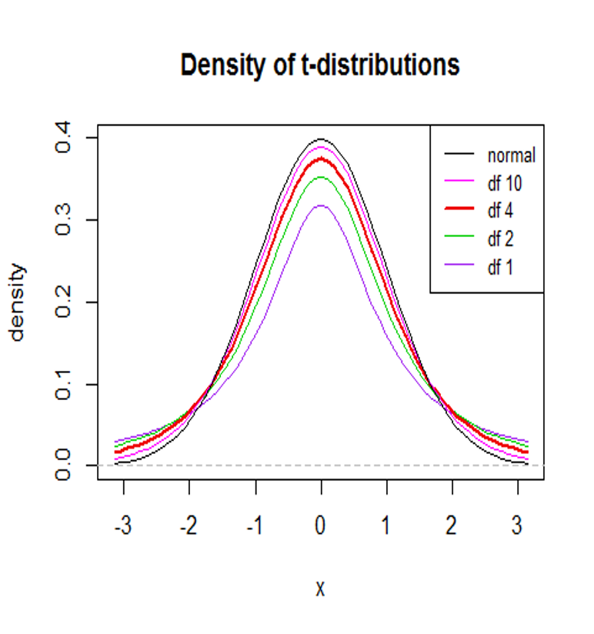
Lecture 4: Student’s t-distribution
Student’s t distribution similar to SND
changes depending on degrees of freedom (df= n-1)
t distribution more “conservative”
smaller n is, the more conservative the t distribution is
At df = ~30 - t distribution becomes close to z distribution

Slide 30
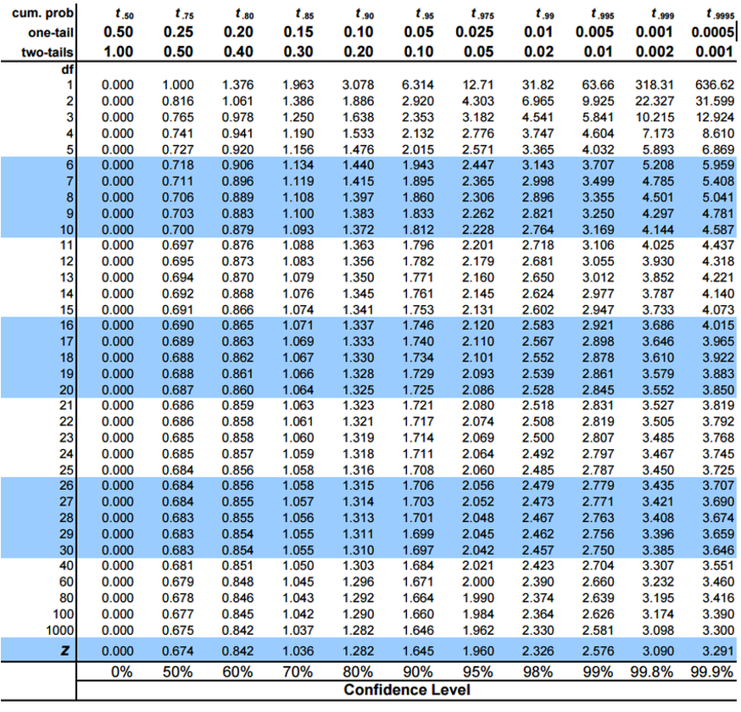
Lecture 4: Student’s t-distribution
To calculate CI for sample from “unknown” population:
$\text{CI}=\overset{‾}{y}±t⋅\frac{s}{\sqrt{n}}$
Where:
ȳ is sample mean
𝑛 is sample size
s is sample standard deviation
t t-value corresponding the probability of the CI
t in t-table for different degrees of freedom (n-1)

Slide 31
Lecture 4: Student’s t-distribution
Here is a t-table
Values of t that correspond to probabilities
Probabilities listed along top
Sample dfs are listed in the left-most column
Probabilities are given for one-tailed and two-tailed “questions”

Slide 32
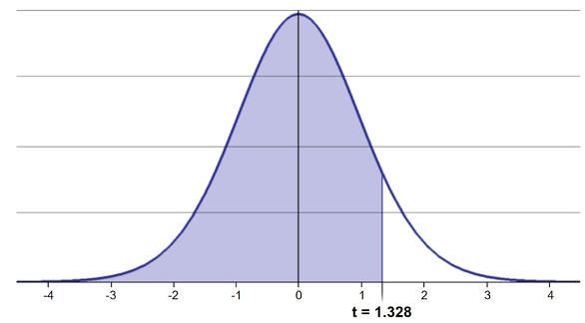
Lecture 4: Student’s t-distribution
One-tailed questions: area of distribution left or (right) of a certain value
n=20 (df=19) - 90% of the observations found left
t= 1.328 (10% are outside)

Slide 33
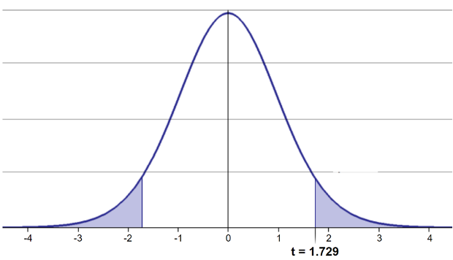
Lecture 4: Student’s t-distribution
Two-tailed questions refer to area between certain values
n= 20 (df=19), 90% of the observations are between
t=-1.729 and t=1.729 (10% are outside)

Slide 34
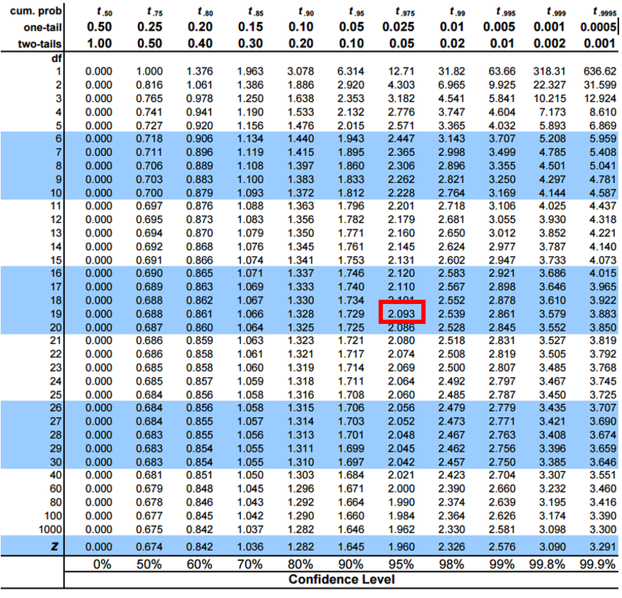
Lecture 4: Student’s t-distribution
Let’s calculate CIs again:
Use two-sided test
95% CI Sample A: = 51.7 ± 1.984 * (12/(208^0.5)) = 1.650788
The 95% CI is between 50.05 and 53.35
“The 95% CI for the population mean from sample A is 51.7 ± 1.65”

Slide 35
Lecture 4: Student’s t-distribution
So:
Can assess confidence that population mean is within a certain range
Can use t distribution to ask questions like:
“What is probability of getting sample with mean = ȳ from population with mean = µ?“ (1 sample t-test)
“What is the probability that two samples came from same population?” (2 sample t-test)

Slide 36
Lecture 4: Next steps
For example
what is probability that population X is the same as our lakes population?
How would you assess this question using what we learned?

Slide 37
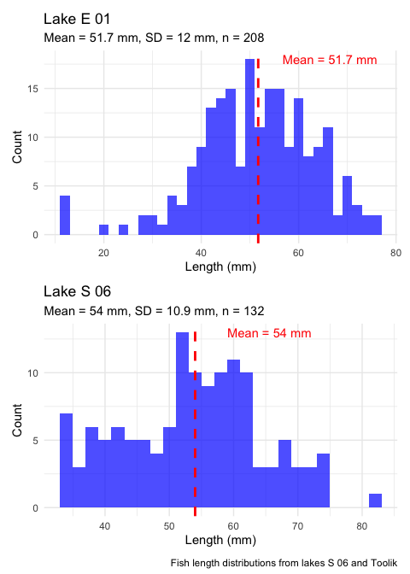
Lecture 4: Next steps
Let’s calculate the 95% CI for population X
Use two-sided test
95% CI Sample X: = 54 ± 1.984 * (10.9/(132^0.5)) = 1.882267 The 95% CI is between 52.12 and 55.88
Notice: the 95% confidence interval contains 51.7
What does this tell us about population X?

Slide 38
Lecture 4: Statistical hypothesis testing
Major goal of statistics:
inferences about populations from samples assign degree of confidence to inferences
Statistical H-testing:
formalized approach to inference
hypotheses ask whether samples come from populations with certain properties
often interested in questions about population means (but not only)

Slide 39
Lecture 4: Statistical hypothesis testing
Relies on specifying null hypothesis (Ho) and alternate hypothesis (Ha)
Ho is the hypothesis of “no effect”
(two samples from population with same mean, sample is from population of mean=0)
Ha (research hypothesis) the opposite of the Ho

Slide 40
Lecture 4: Statistical hypothesis testing
p = 0.3 means that if study repeated 100 times
would get this (or more extreme) result due to chance 30 times
p = 0.03 means that if study repeated 100 times
would get this (or more extreme) result due to chance 3 times
Which p-value suggests Ho likely false?

Slide 41
Lecture 4: Statistical hypothesis testing
At what point reject Ho?
p < 0.05 conventional “significance threshold” (α)
p < 0.05 means:
if Ho is true - if study repeated 100 times
would get this (or more extreme) result less than 5 times due to chance

Slide 42
Lecture 4: Statistical hypothesis testing
α is the rate at which we will reject a true null hypothesis (Type I error rate)
Lowering α will lower likelihood of incorrectly rejecting a true null hypothesis (e.g., 0.01, 0.001)
Both hypotheses and α are specified BEFORE collection of data and analysis

Slide 43
Lecture 4: Statistical hypothesis testing
Traditionally α=0.05 is used as a cut off for rejecting null hypothesis
Nothing magical about 0.0 - actual p-values need to be reported.
p-value range | Interpretation
P > 0.10 | No evidence against Ho - data appear consistent with Ho
0.05 < P < 0.10 | Weak evidence against the Ho in favor of Ha
0.01 < P < 0.05 | Moderate evidence against Ho in favor of Ha
0.001 < P < 0.01 | Strong evidence against Ho in favor of Ha
P < 0.001 | Very strong evidence against Ho in favor of Ha

Slide 44

Lecture 4: Statistical hypothesis testing
Fisher:
p-value as informal measure of discrepancy betwen data and Ho
“If p is between 0.1 and 0.9 there is certainly no reason to suspect the hypothesis tested. If it is below 0.02 it is strongly indicated that the hypothesis fails to account for the whole of the facts. We shall not often be astray if we draw a conventional line at .05 …”

Slide 45
Lecture 4: Statistical hypothesis testing
General procedure for H testing:
Specify Null (Ho) and alternate (Ha)
Determine test (and test statistic) to be used
Test statistic is used to compare your data to expectation under Ho (null hypothesis)
Specify significance (α or p value) level below which Ho will be rejected

Slide 46
Lecture 4: Statistical hypothesis testing
General procedure for H testing:
Collect data - Perform test
If p-value < α, conclude Ho is likely false and reject it
If p-value > α, conclude no evidence Ho is false and retain it

